Slide 1
GIT Team Working
Adrian Yuan-XVM683

Slide 2
Agenda
Top 10 commands for team working
Introduction Atlassian Stash
Repeater Practices sharing
Introduction Google Gerrit

Slide 3
GIT basic workflow
pull
branch
commit
merge
push

Slide 4
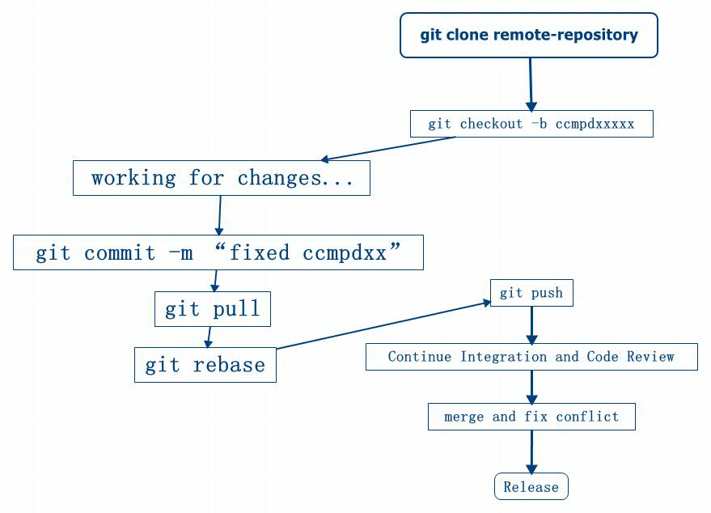
GIT basic team working

Slide 5
Top 10 Commands
git clone
git remote
git pull
git fetch
git merge
git rebase
git push
git cherry-pick
git log
git bisect

Slide 6
Git clone
git clone: Clone a repository into a new directory
git clone $link-remote-repository $local-dir
git clone https://zch49git01:8443/scm_sandbox
git clone ssh://XVM683@zch49git01:29418/scm_sandbox
git clone ssh://xvm683@zch49view02/data/xvm683/demo1
git clone /data/xvm683/demo1
other: ftp/rsync/...
git clone -o cdc ssh://XVM683@zch49git01:29418/scm_sandbox

Slide 7

git remote
git remote - Manage set of tracked repositories
git remote show origin: it’ll list all branch of origin repository.
git remote -v: show current origin setting in your local repository.
git remote add name-repository url: add new repository

Slide 8
Git pull
git pull： Fetch from and integrate with another repository or a local branch
git pull $remote-repo $remote-branch:$local-branch
git pull== git pull origin master $current_branch: it’ll get remote changes and integrate into local branch
git pull --rebase: fetch the remote objects. then rebase on local branch
Tracking branch: the remote branch will be automatically mark as the tracking branch when we clone one remote repository. eg: master->remote/master
git pull =git fetch followed by git merge FETCH_HEAD

Slide 9
Git fetch
git fetch: Download objects and refs from another repository
git fetch $remote-repo-name $remote-branch
git fetch == git fetch origin master/

Slide 10



How to choice?
before pull
after pull/fetch+merge
after pull --rebase

Slide 11
Suggestion one:
1:git checkout -b ccmpdxxx
2: make changes
3: ready to commit; git stash
4: git pull --rebase;
5: git stash pop

Slide 12
git merge
git-merge - Join two or more development histories together
git merge $from_branch $to_branch
git merge $tag1 $tag2
git merge $commit1 $commit2
git merge --no-commit dev_branch
git merge --no-ff branch_name
merge setting:
(1)merge.conflictstyle
merge(<<<<<<<, =======, >>>>>>>. )/diff3(<<<<<<<, |||||||, >>>>>>>)
(2)merge.tool
kdiff3,tkdiff,gvimdiff,ecmerge,vimdiff

Slide 13
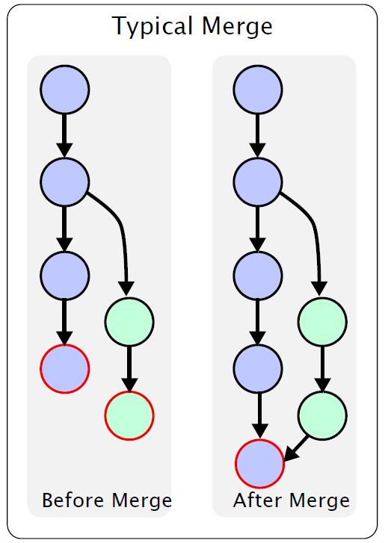
Git merge(type)
Typical merge in ClearCase

Slide 14
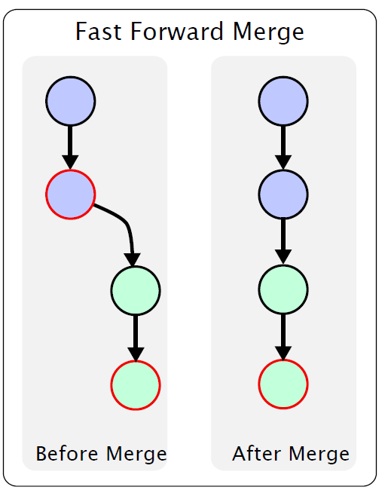
Fast forward merge
If Master has not diverged, instead
of creating a new commit, git will
just point master to the latest
commit of the feature branch.

Slide 15
merge strategy
Default merge strategy: recursive
-s recursive -X theirs branch_name
:create the new commit and keep content of from-branch
-s recursive -X ours.(it’s totally different with -s ours)
:create the new commit and keep current content of current branch when there is any conflict. it’ll merge others into current branch if there is not any conflict.
ours merge strategy:git merge -s ours ccmpd1123
create the new commit and keep current content of current branch, and ignore all changes from other branch
octopus strategy:
merge the head from more than 2 branch. but refuses to do a complex merge that needs manual resolution.
subtree strategy:
resolve strategy:This can only resolve two heads (i.e. the current branch and another branch you pulled from) using a 3-way merge algorithm.

Slide 16
merge conflict
The area where a pair of conflicting changes happened is marked with markers <<<<<<<, =======, and >>>>>>>. The part before the ======= is typically your side, and the part afterwards is typically their side.
resolve the conflict:
option1: decide to cancel this merge.: git merge --abort
option2: fix the conflict:

Slide 17
GIT merge(tips)
Please use git rebase if you want to get the latest bug fixes and new feature added. and you know what’s the impact of rebase;
git merge can be used to :
from developer branch into integration branch
merge from one developer branch into another
try your best to avoid the typical merge :)

Slide 18
Git rebase
git rebase: Forward-port local commits to the updated upstream head
git rebase -i: interactive rebase.
git rebase $from_branch $to_branch
git rebase --onto <newbase>
git rebase --continue (resolve the conflict, then continue to rebase)
git rebase --skip (get the conflict, jump the current commit)
git rebase --abort (get the conflict, cancel the rebase)

Slide 19
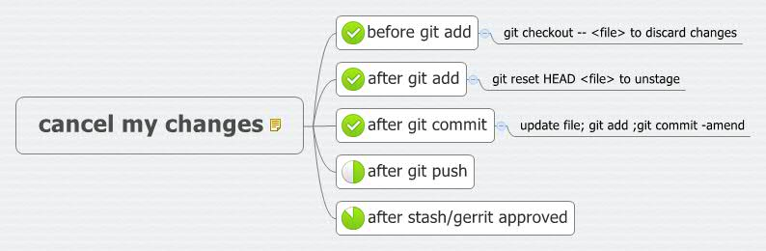
Redo-History

Slide 20

repentance or clean the log?
S1: I was committed for any changes.
but i want to combine the latest commits together;
git reset --soft <the last clearly commit point>
...make the changes…
git add .
git commit -m “what was done”

Slide 21
S1 with rebase
git rebase -i HEAD~3: redo the latest 3 commits
Commands:
# p, pick = use commit
# r, reword = use commit, but edit the commit message
# e, edit = use commit, but stop for amending
# s, squash = use commit, but meld into previous commit
# f, fixup = like "squash", but discard this commit's log message
# x, exec = run command (the rest of the line) using shell

Slide 22
repentance or clean the log?
S2: i want to drop one commit point in history?
git reset --soft <the last clearly commit point>
git cherry-pick <commit>
...make the changes…
git add .
git commit -m “what was done”

Slide 23
Commit for team working(Tips)
Common Rule:
The minimal function to commit, To avoid the big-bang commit and big-bang integration
keep the commit log clean and clearly;
one line commit message for team working

Slide 24
Git push
git push : Update remote refs along with associated objects
Setup the upstream branch:
git checkout -b zch49_xvm683_demo_remote
git push -u origin master; # then zch49_xvm683_demo_remote is the tracking branch of origin/master
Remove the remote branch:
git push origin :zch49_xvm683_demo_remote is same as :
git push origin --delete zch49_xvm683_demo_remote
Push the tags into remote repo:
git push --tags or git push --all
git push changes from GIT V2.0
git config --global push.default simple--only push current branch
before V2.0
git config --global push.default matching --push all matching branch

Slide 25
Git cherry-pick
git-cherry-pick - Apply the changes introduced by some existing commits
git cherry-pick commit-id
git cherry-pick --continue
git cherry-pick --quit
git cherry-pick --abort

Slide 26
Git log-git log for team working:
git log --no-merges: check the commit log what is not the merge operation.
..
To check what will be merge into master:
git log master..ccmpd: it’ll show the content what can be found on ccmpd branch , but not shown on master
git log master..ccmpd
git log ^master ccmpd
git log ccmpd --not master
To check what will be push into remote server:
git log origin/master..HEAD
…
git log --left-right ccmpd1...ccmpd2: it’ll show the content what can be found on one branch, but not on all of branch

Slide 27
Git bisect
git blame---get who did it/when did it;
git grep---get this defect was deployed;
git bisect---get where is the defect commit;
git bisect start
git bisect good commit-id
git bisect bad commit-id
…
git bisect reset

Slide 28
Tips(A)
how to list all branch on remote repository?
git branch -r
how to create the branch from remote branch?
git checkout -b $new_branch_name origin/master

Slide 29

PCR Repeater Practices
30 minutes.

Slide 31

DGBV47
CG569
2015-4-23

Slide 32
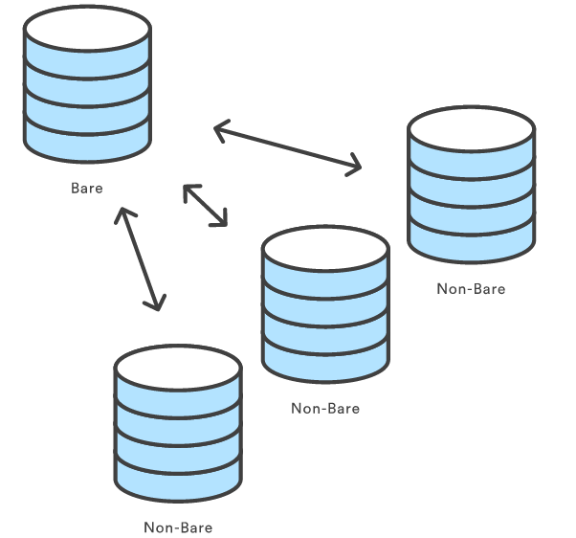
Setting up a repository – init, clone
‹#›

Slide 33
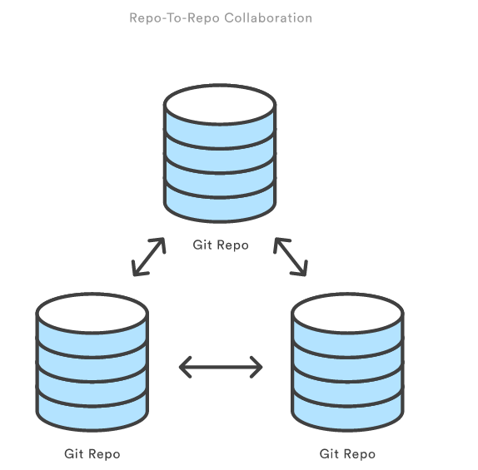
Setting up a repository
‹#›

Slide 34
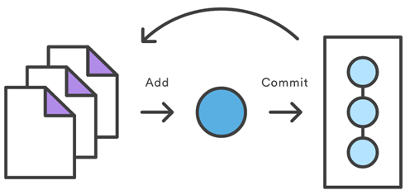
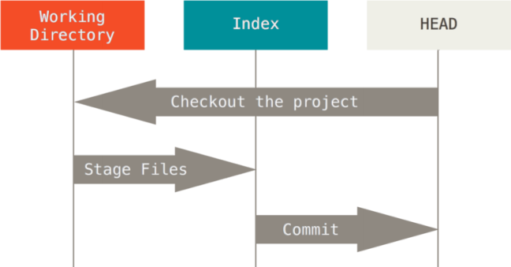
Saving changes – add, commint
‹#›

Slide 35
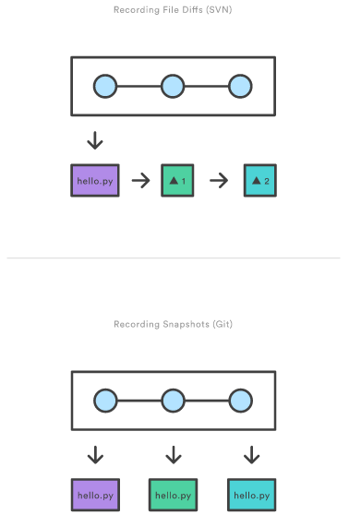
Saving changes
‹#›

Slide 36
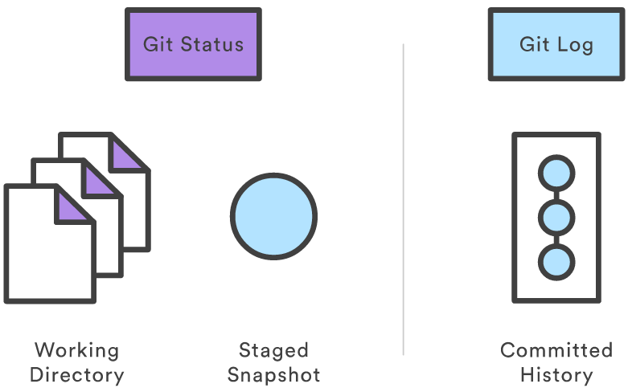
Inspecting a repository – status, log
‹#›

Slide 37
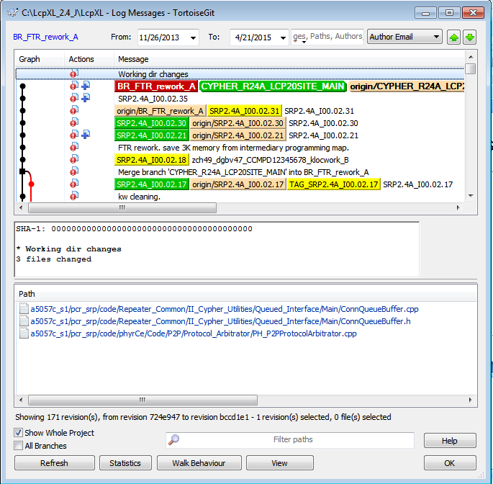
Inspecting a repository – status, log
‹#›

Slide 38
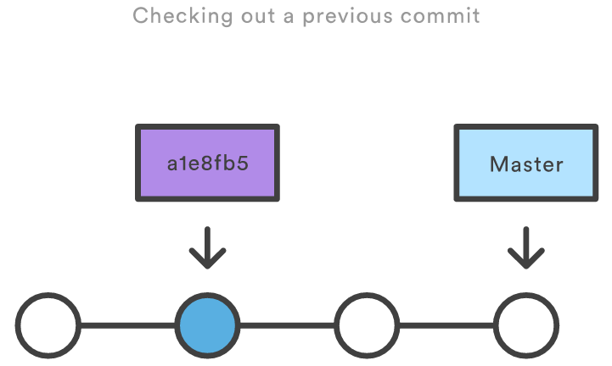
Viewing old commits - checkout
‹#›

Slide 39
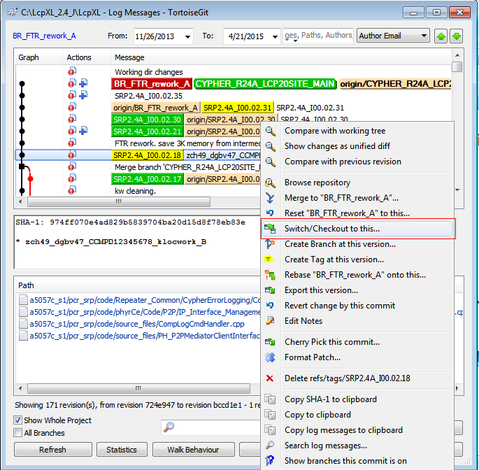
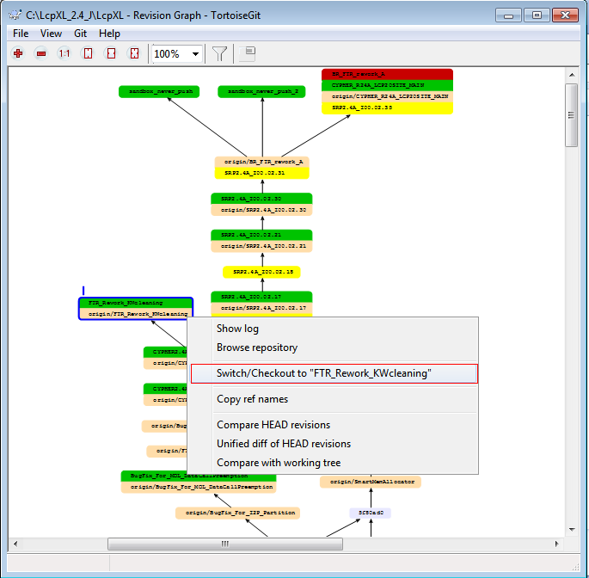
Viewing old commits - checkout
‹#›

Slide 40
Undoing Changes – revert, reset, clean
‹#›

Slide 41
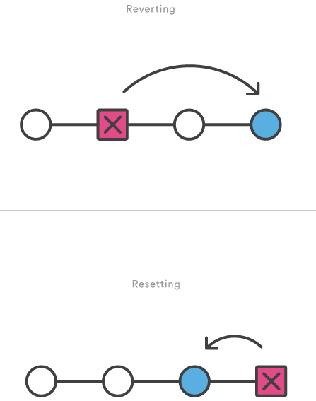
Undoing Changes – revert, reset
‹#›

Slide 42
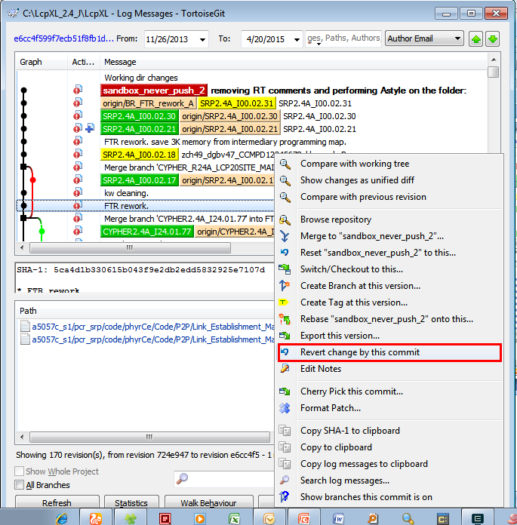
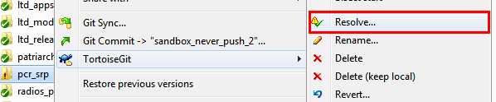
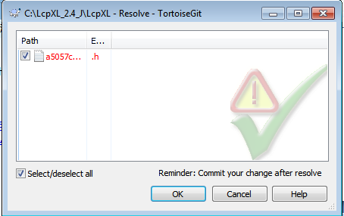
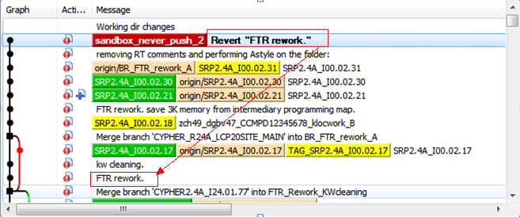
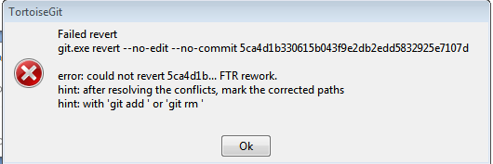
Undoing Changes – revert
‹#›

Slide 43
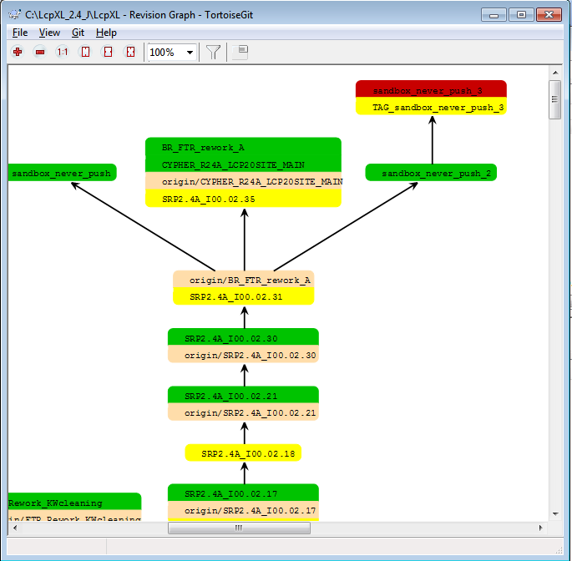
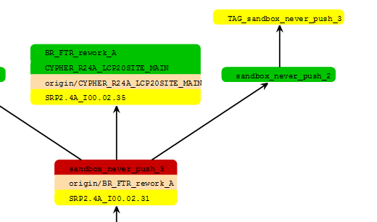
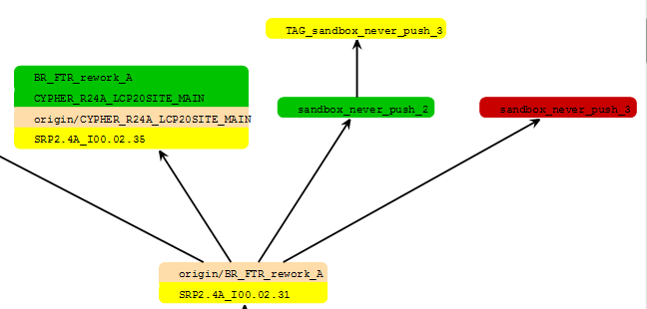
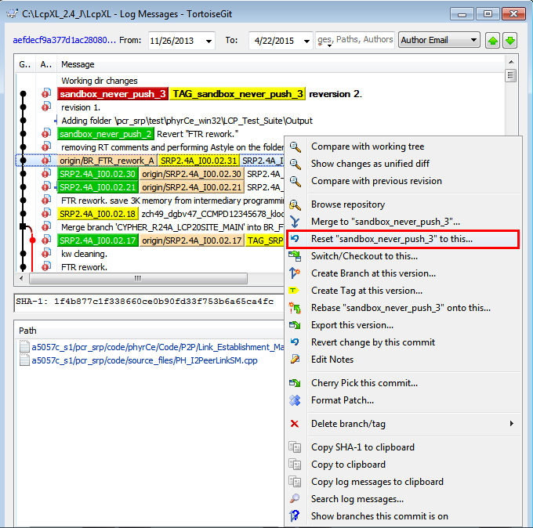
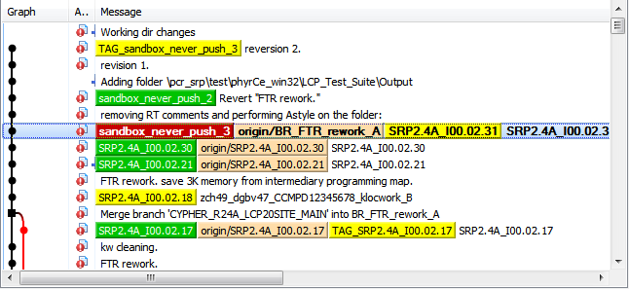
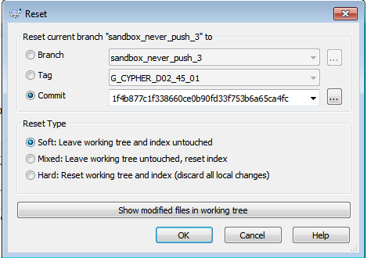
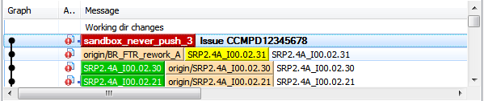
Undoing Changes - reset
‹#›

Slide 44
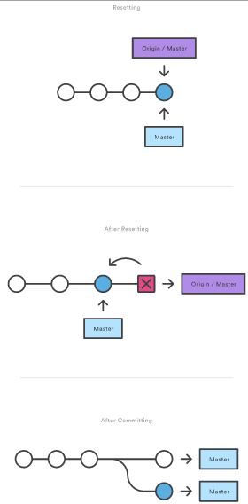
Undoing Changes - reset
Don’t Reset Public History
‹#›

Slide 45
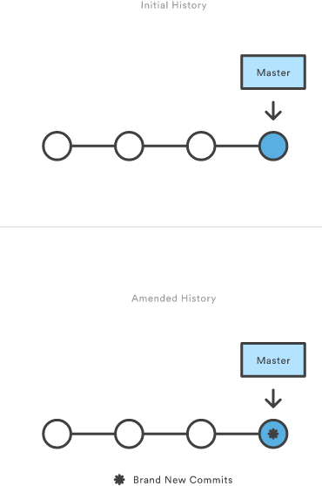
Rewriting history – commit amend
‹#›

Slide 46
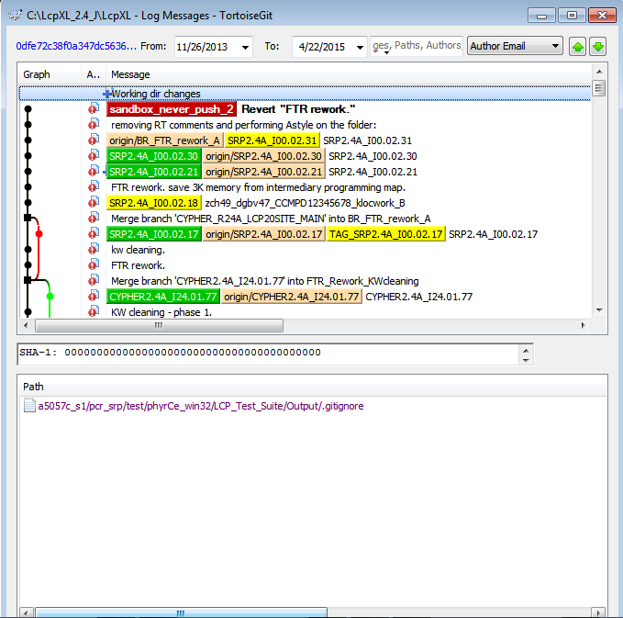
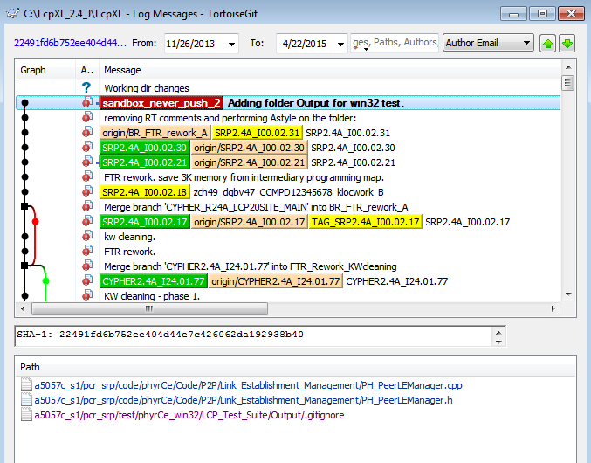
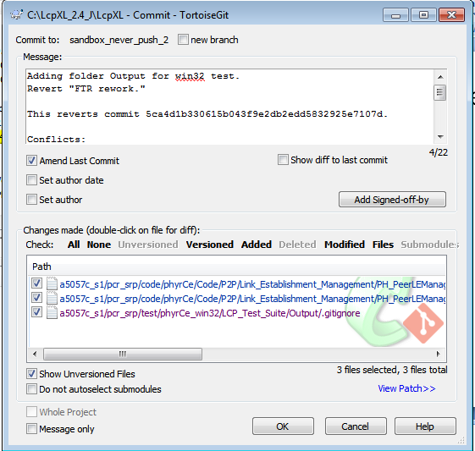
Rewriting history – commit amend
‹#›

Slide 47
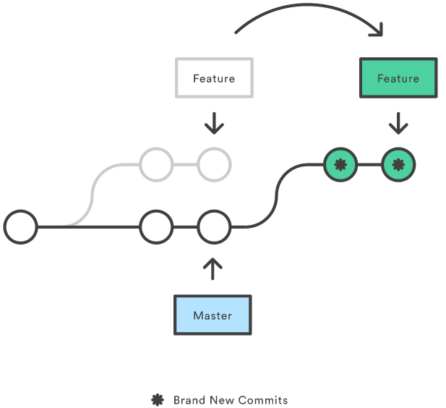
Rewriting history - rebase
‹#›

Slide 48
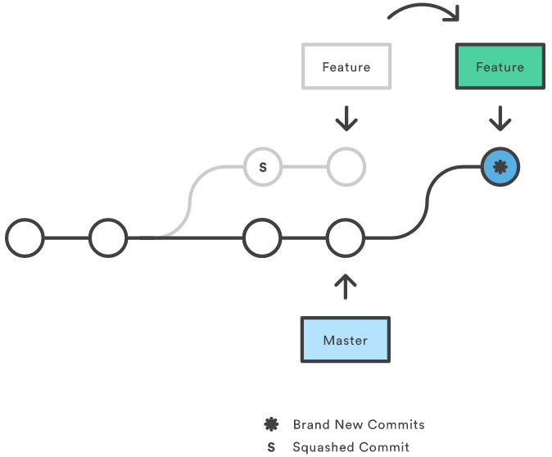
Rewriting history – rebase -i
‹#›

Slide 49
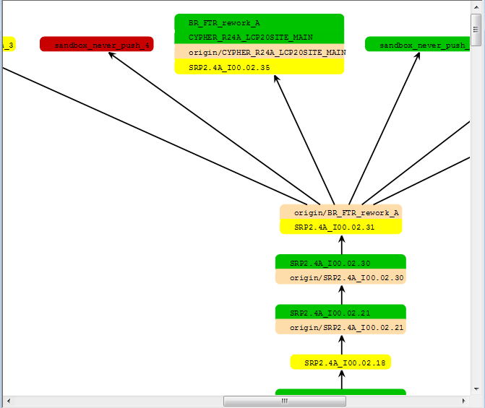
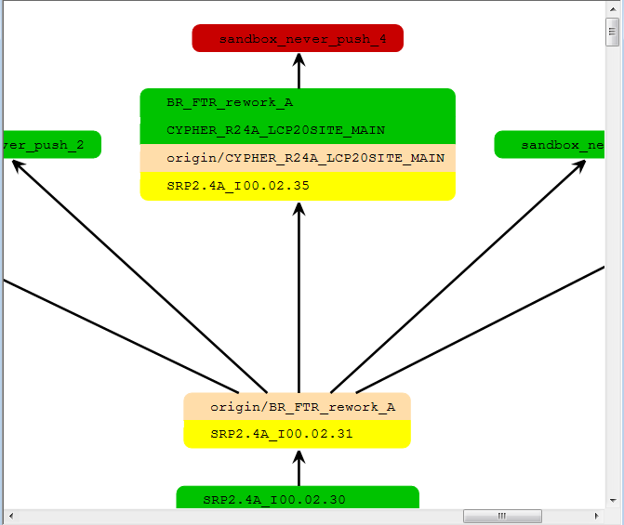
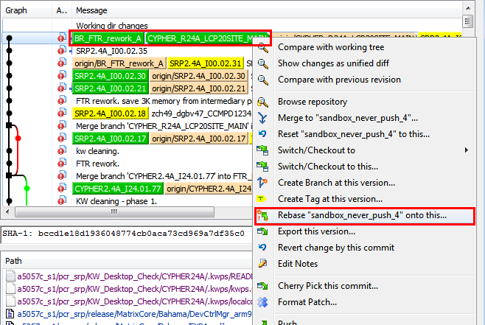
Rewriting history – rebase
‹#›

Slide 50
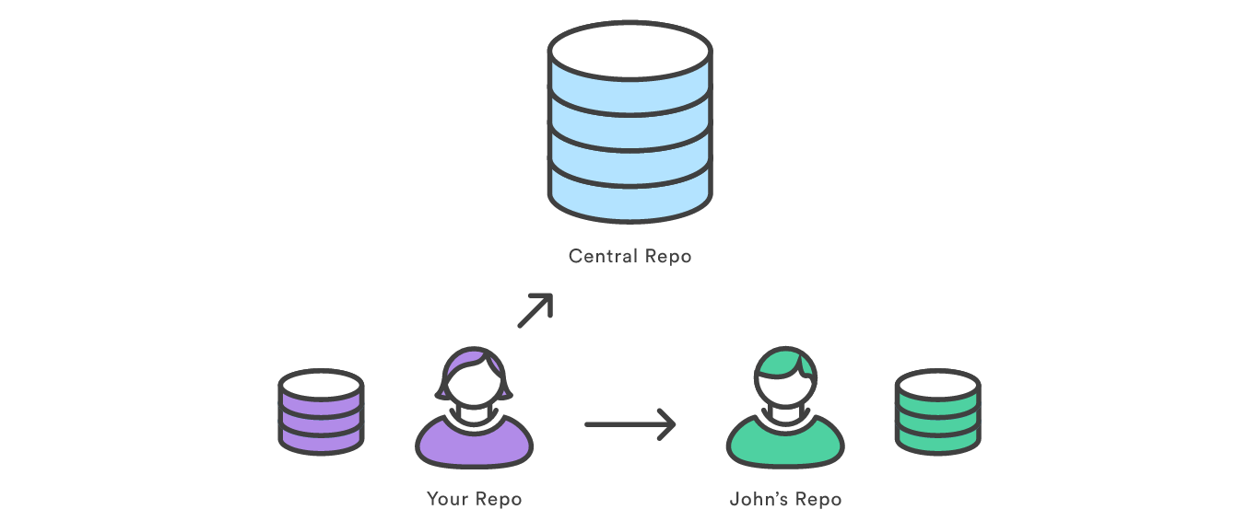
Syncing - remote
‹#›

Slide 51
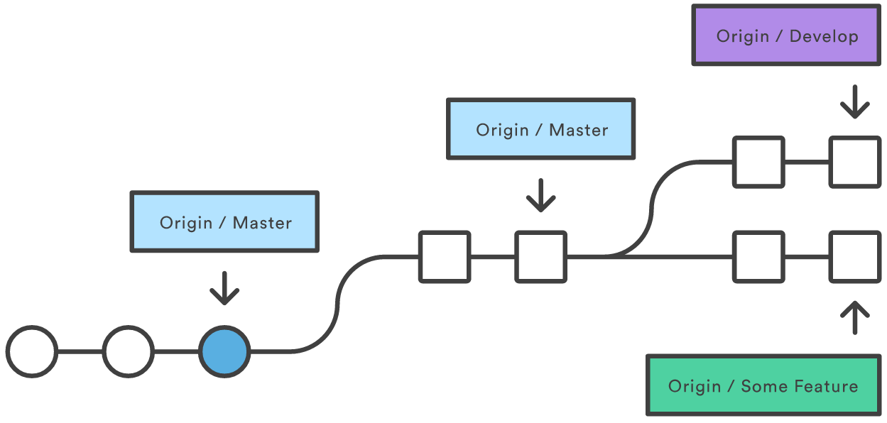
Syncing - fetch
‹#›

Slide 52
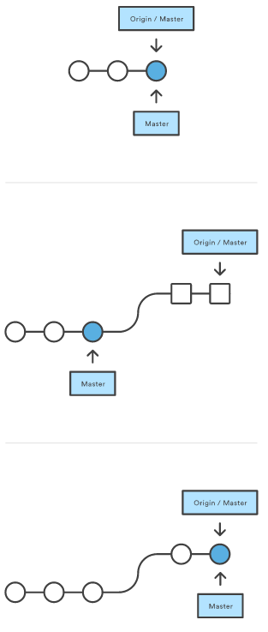
Syncing – pull
‹#›

Slide 53
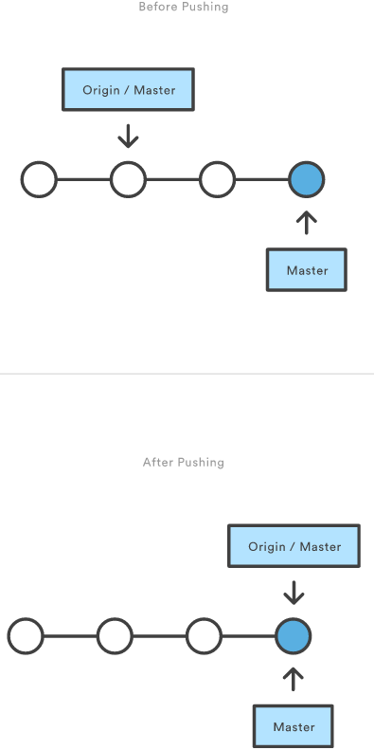
Syncing - push
‹#›
Notes:
Git prevents you from overwriting the central repository’s history by refusing push requests when they result in a non-fast-forward merge. So, if the remote history has diverged from your history, you need to pull the remote branch and merge it into your local one, then try pushing again.

Slide 54
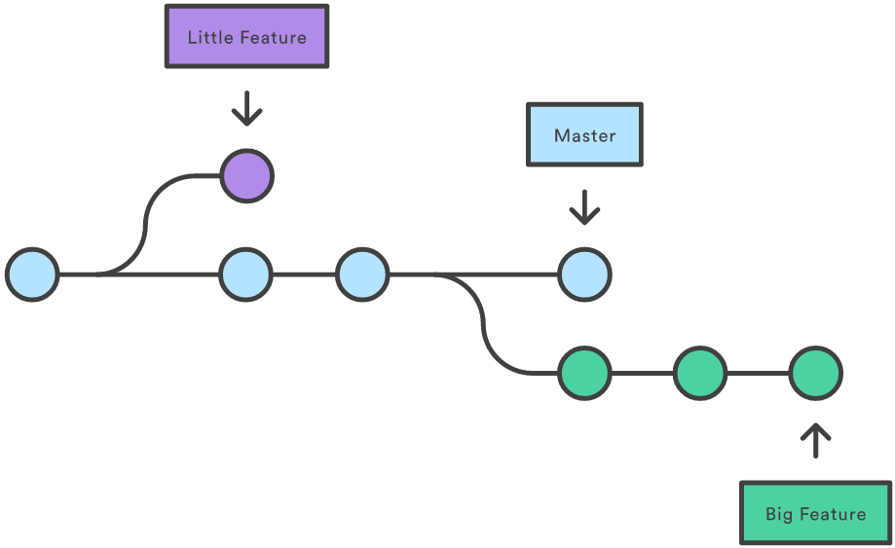
Using Branches – branch, checkout, merge
‹#›
Notes:
Git stores a branch as a reference to a commit. Whereas merges in SVN are done on a file-basis, Git lets you work on the more abstract level of commits.

Slide 55
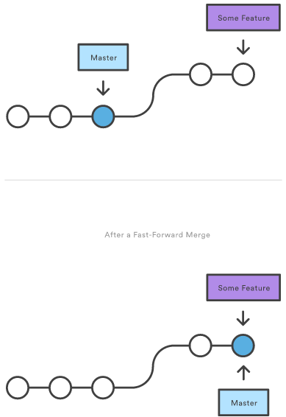
Using Branches – merge ( fast forward)
‹#›
Notes:
Git stores a branch as a reference to a commit. Whereas merges in SVN are done on a file-basis, Git lets you work on the more abstract level of commits.

Slide 56
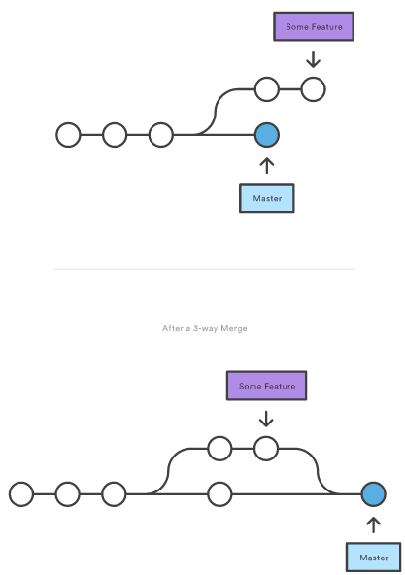
Using Branches - merge
‹#›
Notes:
Git stores a branch as a reference to a commit. Whereas merges in SVN are done on a file-basis, Git lets you work on the more abstract level of commits.

Slide 57
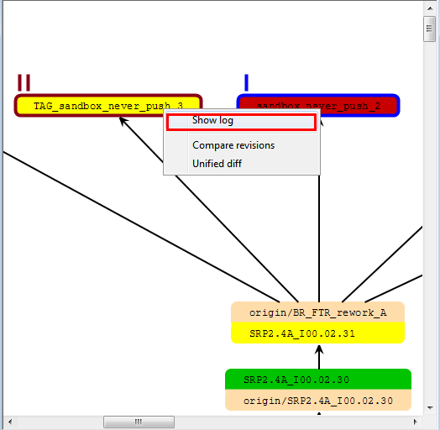
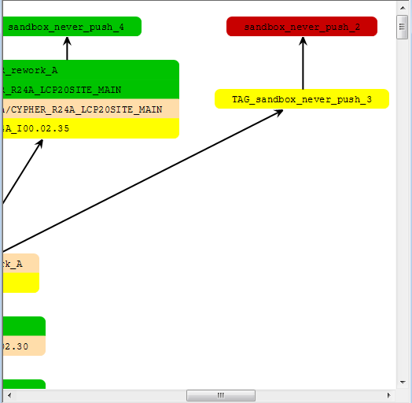
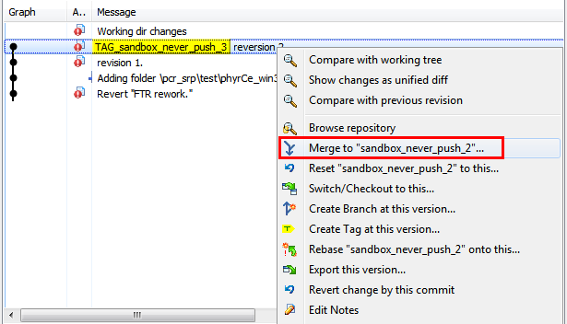
Using Branches - merge
‹#›
Notes:
Git stores a branch as a reference to a commit. Whereas merges in SVN are done on a file-basis, Git lets you work on the more abstract level of commits.

Slide 58
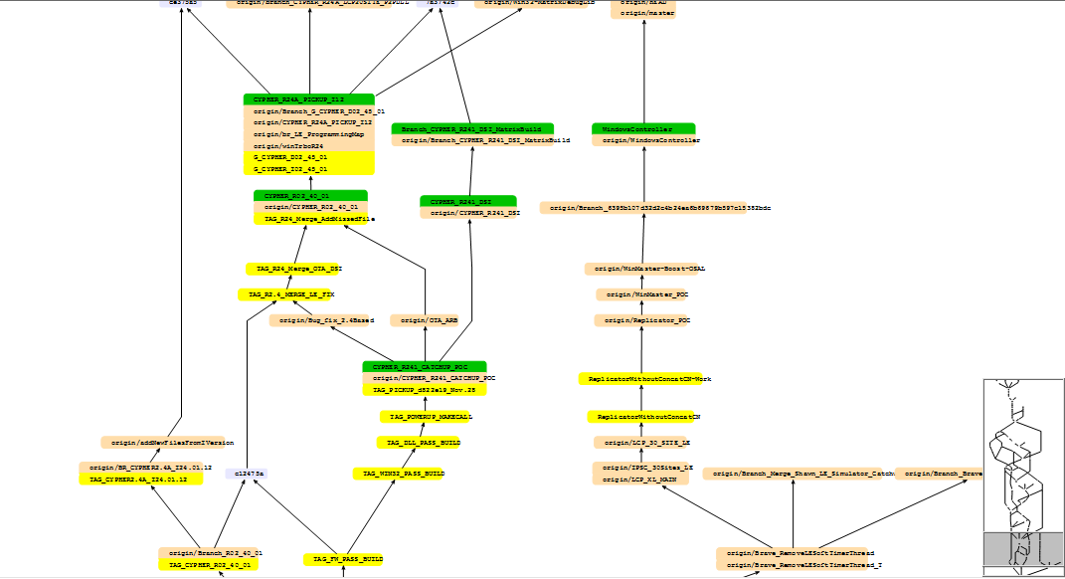
Using Branches - merge
‹#›

Slide 59
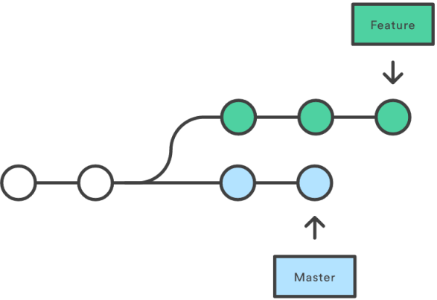
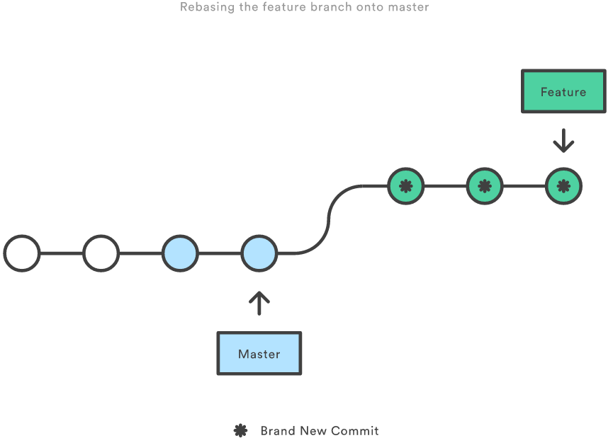

Merging vs. Rebasing
‹#›

Slide 60


Merging vs. Rebasing
‹#›

Slide 61

Reset, Checkout, and Revert
‹#›

Slide 62

Reset, Checkout, and Revert
‹#›

Slide 63

Reset, Checkout, and Revert
‹#›

Slide 64


Reset, Checkout, and Revert
‹#›

Slide 65

Reset, Checkout, and Revert
‹#›

Slide 66

Reset - File-level Operations
‹#›
Notes:
When invoked with a file path, git reset updates the staged snapshot to match the version from the specified commit.
The --soft, --mixed, and --hard flags do not have any effect on the file-level version of git reset, as the staged snapshot is alwaysupdated, and the working directory is never updated.

Slide 67

Checkout - File-level Operations
‹#›
Notes:
Checking out a file is similar to using git reset with a file path, except it updates the working directory instead of the stage.

Slide 68


Cherry pick
‹#›

Slide 69

TOOLS - blame
‹#›

Slide 70









TOOLS - bisect
‹#›

Slide 71




TOOLS – stash
‹#›

Slide 72





TOOLS – Compare
‹#›

Slide 73
Reference
http://git-scm.com/doc
http://stackoverflow.com/questions/tagged/git
http://download.tortoisegit.org
‹#›

Slide 74
Stash
Introduction Atlassian Stash
common setting
manager code repository
branch and code review workflow
continue integration with Stash

Slide 75
Stash
MSI Stash website:
http://stash.mot-solutions.com:7990

Slide 76
Funny
Funny for Gerrit VS Stash

Slide 77

GIT with Continuous Integration

